Slide 1
Lecture 4: Association Measures
Bridget McInnes
12 February 2018

Slide 2
Evaluating Ngrams
Perplexity
intrinsic evaluation metric for N-gram language models
the idea: given two probabilistic models, the better model:
is the one that has a tighter fit to the test data
that better predicts the details of the test data
measure this: looking at the probability the model assigns to the test data
the better model will assign a high probability to the test data.

Slide 3
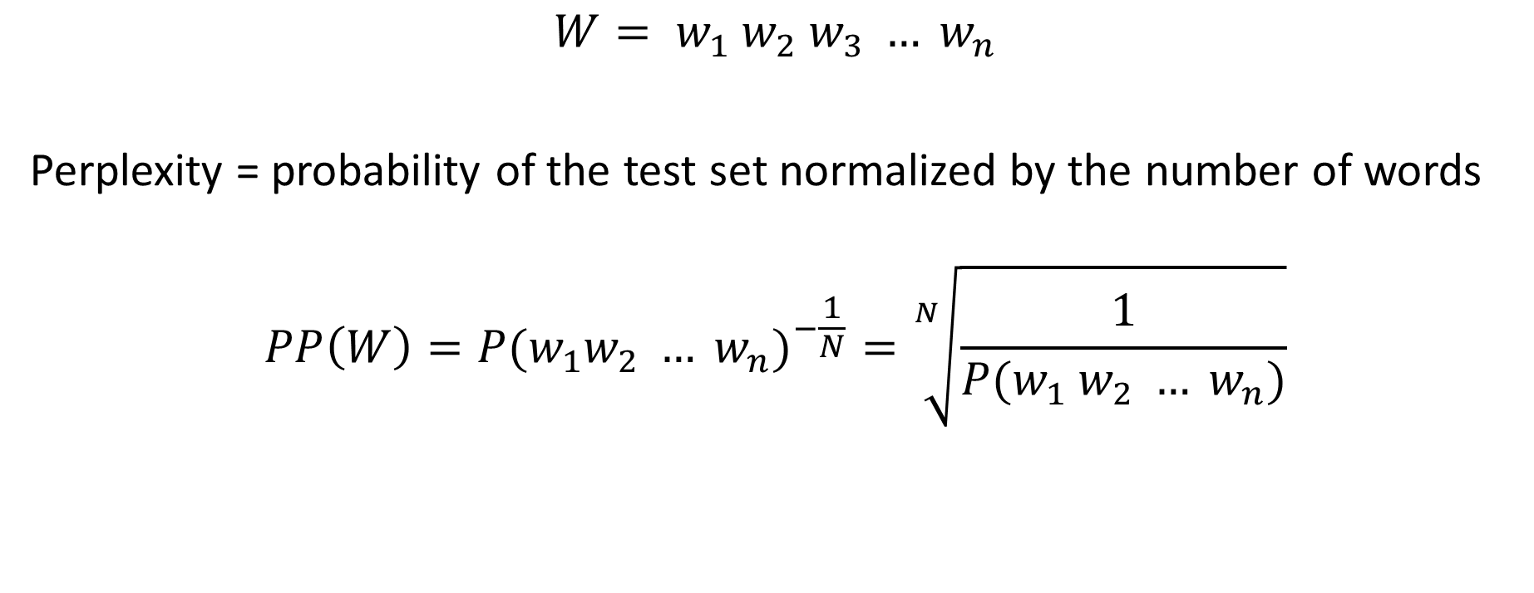
Perplexity (PP)
$$W= w_{1} w_{2} w_{3} … w_{n}$$
Perplexity = probability of the test set normalized by the number of words
$$PP\left(W\right)={P(w_{1}w_{2} … w_{n})}^{−\frac{1}{N}}=\sqrt[N]{\frac{1}{P(w_{1} w_{2} … w_{n})}}$$

Slide 4
Perplexity (PP)
$$W= w_{1} w_{2} w_{3} … w_{n}$$
Perplexity = probability of the test set normalized by the number of words
$$PP\left(W\right)={P(w_{1}w_{2} … w_{n})}^{−\frac{1}{N}}=\sqrt[N]{\frac{1}{P(w_{1} w_{2} … w_{n})}}$$
What is the difficulty here?

Slide 5
Perplexity (PP)
$$W= w_{1} w_{2} w_{3} … w_{n}$$
Perplexity = probability of the test set normalized by the number of words
$$PP\left(W\right)={P(w_{1}w_{2} … w_{n})}^{−\frac{1}{N}}=\sqrt[N]{\frac{1}{P(w_{1} w_{2} … w_{n})}}$$
And what Rule did we learn with Language
Modeling that we can apply here?

Slide 6

Perplexity: Chain Rule
Chain rule: allows us to decompose the probability into a product of component conditional probabilities
$$PP\left(W\right)={P(w_{1}w_{2} … w_{n})}^{−\frac{1}{N}}=\sqrt[N]{\frac{1}{P(w_{1} w_{2} … w_{n})}}$$
$$= \sqrt[N]{\prod_{1}^{N}{\frac{1}{P(w_{i}|{w_{1}w_{2} …w}_{i−1})}}}$$

Slide 7
Perplexity: Chain Rule
Chain rule: allows us to decompose the probability into a product of component conditional probabilities
$$PP\left(W\right)={P(w_{1}w_{2} … w_{n})}^{−\frac{1}{N}}=\sqrt[N]{\frac{1}{P(w_{1} w_{2} … w_{n})}}$$
$$= \sqrt[N]{\prod_{1}^{N}{\frac{1}{P(w_{i}|{w_{1}w_{2} …w}_{i−1})}}}$$

Slide 8
Perplexity: Chain Rule
Chain rule: allows us to decompose the probability into a product of component conditional probabilities
$$PP\left(W\right)={P(w_{1}w_{2} … w_{n})}^{−\frac{1}{N}}=\sqrt[N]{\frac{1}{P(w_{1} w_{2} … w_{n})}}$$
$$= \sqrt[N]{\prod_{1}^{N}{\frac{1}{P(w_{i}|{w_{1}w_{2} …w}_{i−1})}}}$$
And now what other Rule did we learn with Language
Modeling that we can apply here?

Slide 9
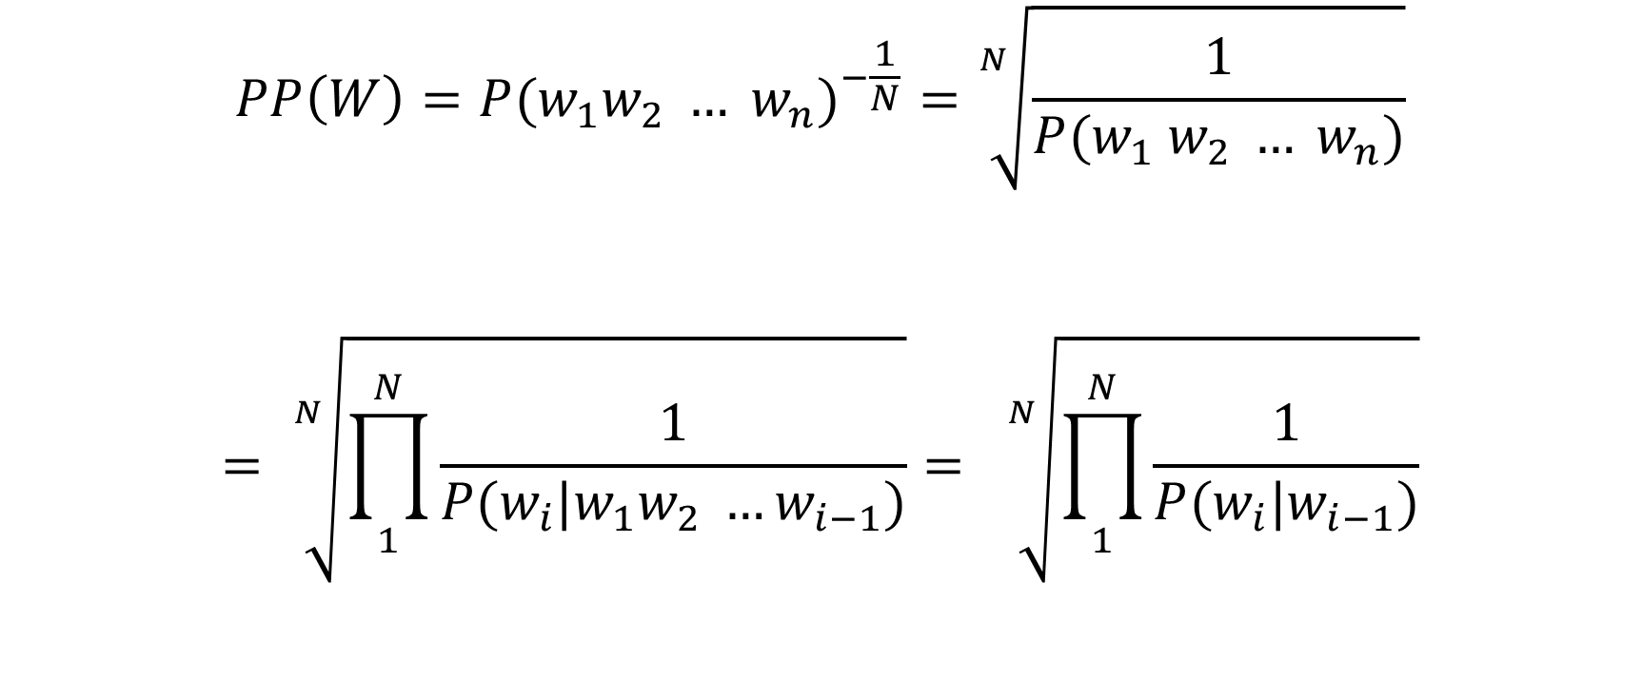
Perplexity: Bayes Rule
$$PP\left(W\right)={P(w_{1}w_{2} … w_{n})}^{−\frac{1}{N}}=\sqrt[N]{\frac{1}{P(w_{1} w_{2} … w_{n})}}$$
$$= \sqrt[N]{\prod_{1}^{N}{\frac{1}{P(w_{i}|{w_{1}w_{2} …w}_{i−1})}}}= \sqrt[N]{\prod_{1}^{N}{\frac{1}{P(w_{i}|w_{i−1})}}}$$

Slide 10
Note
Because of the inverse: The higher the conditional probability of the word sequence the lower the perplexity
Therefore
Minimizing perplexity is equivalent to maximizing the test set probability according to the language model

Slide 11
Entropy
Perplexity is based on the information-theoretic notion of cross-entropy
Entropy =
measure of how much information there is in a particular grammar
how much information is there to predict a given langage
for a given N-gram grammar, how predictive is it about what the next word will be?

Slide 12

Entropy
$$H\left(X\right)=−\sum_{x∈X}{p(x)\log_{2}(p\left(x\right))}$$
Technically, you can use any base, but with log base 2,
resulting entropy is measured in bits

Slide 13
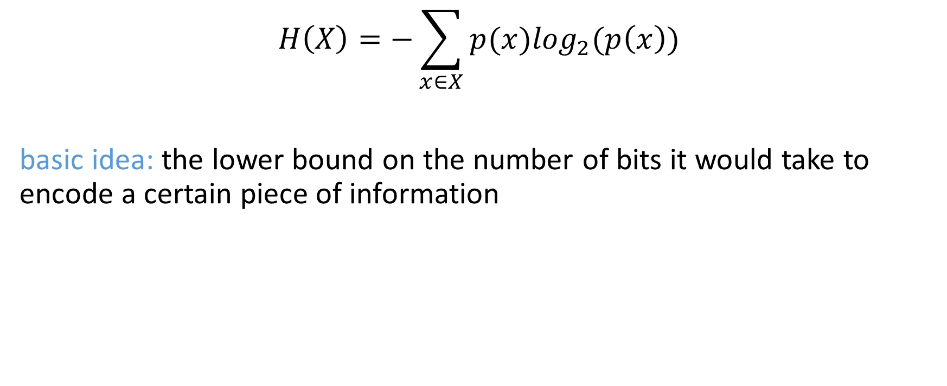
Entropy
$$H\left(X\right)=−\sum_{x∈X}{p(x)\log_{2}(p\left(x\right))}$$
basic idea: the lower bound on the number of bits it would take to encode a certain piece of information

Slide 14
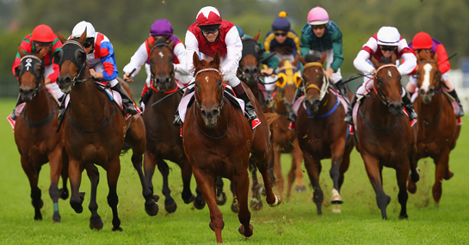
Horse example
You are at Colonial Downs
as you are walking around you want
to send a short message to your bookie
to tell him which horse to bet on
you are paranoid that our wife/husband (who works for NSA) will find out … especially if you lose … which you won’t … hopefully

Slide 15
Horse example
You could just use the binary representation of the horse’s number:
If we spent the entire day at the track,
it would be sending 3 bits per race
Horse 1 | 000 | Horse 5 | 100
Horse 2 | 001 | Horse 6 | 101
Horse 3 | 010 | Horse 7 | 110
Horse 4 | 011 | Horse 8 | 111

Slide 16
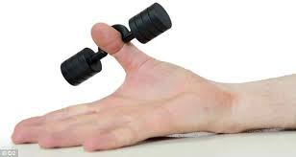
Horse example
You could just use the binary representation of the horse’s number:
If we spent the entire day at the track,
it would be sending 3 bits per race
But you have not been doing your texting exercises
and worry that you will end up with a crippled thumb before the day is over
Horse 1 | 000 | Horse 5 | 100
Horse 2 | 001 | Horse 6 | 101
Horse 3 | 010 | Horse 7 | 110
Horse 4 | 011 | Horse 8 | 111

Slide 17
Horse example
Say we know the distribution of the bets placed on the horses and
that we represent it as the prior probability of each horse
Horse 1 | 1/2 | Horse 5 | 1/64
Horse 2 | 1/4 | Horse 6 | 1/64
Horse 3 | 1/8 | Horse 7 | 1/64
Horse 4 | 1/16 | Horse 8 | 1/64
$$H\left(x\right)=−\sum_{x ∈X}{P\left(x\right)\log_{2}P\left(x\right)}=−\frac{1}{2}\log{\frac{1}{2}} − \frac{1}{4}log \frac{1}{4} − \frac{1}{8}log\frac{1}{8} −\frac{1}{16}log\frac{1}{16} −4\left(\frac{1}{64}log \frac{1}{64}\right)=2 bits$$

Slide 18
Horse example
Say we know the distribution of the bets placed on the horses and
that we represent it as the prior probability of each horse
Horse 1 | 0 | Horse 5 | 111100
Horse 2 | 10 | Horse 6 | 111101
Horse 3 | 110 | Horse 7 | 111110
Horse 4 | 1110 | Horse 8 | 111111
$$H\left(x\right)=−\sum_{x ∈X}{P\left(x\right)\log_{2}P\left(x\right)}=−\frac{1}{2}\log{\frac{1}{2}} − \frac{1}{4}log \frac{1}{4} − \frac{1}{8}log\frac{1}{8} −\frac{1}{16}log\frac{1}{16} −4\left(\frac{1}{64}log \frac{1}{64}\right)=2 bits$$

Slide 19
Shannon Game
Per letter entropy
Shannon reported 1.3 bits for 27 characters (26 letters + space)
Based on Jefferson the Virginian by Dumas Malone
Considered a bit low due to the corpus chosen
http://math.ucsd.edu/~crypto/java/ENTROPY/

Slide 20
Let’s play a game
? <- What is the first letter?

Slide 21
What is the next letter?
B?

Slide 22
What is the next letter?
Be?

Slide 23
What is the next letter?
Bef?

Slide 24
What is the next letter?
Befo?

Slide 25
What is the next letter?
Befor?

Slide 26
What is the next letter?
Before?

Slide 27
What is the next letter?
Before ?

Slide 28
What is the next letter?
Before s?

Slide 29
What is the next letter?
Before sh?

Slide 30
What is the next letter?
Before she?

Slide 31
What is the next letter?
Before she ?

Slide 32
What is the next letter?
Before she w?

Slide 33
What is the next letter?
Before she wa?

Slide 34
What is the next letter?
Before she was?

Slide 35
What is the next letter?
Before she was ?

Slide 36
What is the next letter?
Before she was W?

Slide 37
What is the next letter?
Before she was Wo?

Slide 38
What is the next letter?
Before she was Won?

Slide 39
What is the next letter?
Before she was Wond?

Slide 40
What is the next letter?
Before she was Wonde?

Slide 41
What is the next letter?
Before she was Wonder?

Slide 42
What is the next letter?
Before she was Wonder ?

Slide 43
What is the next letter?
Before she was Wonder W?

Slide 44
What is the next letter?
Before she was Wonder Wo?

Slide 45
What is the next letter?
Before she was Wonder Wom?

Slide 46
What is the next letter?
Before she was Wonder Woma?

Slide 47
What is the next letter?
Before she was Wonder Woman?

Slide 48
What is the next letter?
Before she was Wonder Woman
?

Slide 49
What is the next letter?
Before she was Wonder Woman
s?

Slide 50
What is the next letter?
Before she was Wonder Woman
sh?

Slide 51
What is the next letter?
Before she was Wonder Woman
she?

Slide 52
What is the next letter?
Before she was Wonder Woman
she ?

Slide 53
What is the next letter?
Before she was Wonder Woman
she w?

Slide 54
What is the next letter?
Before she was Wonder Woman
she wa?

Slide 55
What is the next letter?
Before she was Wonder Woman
she was?

Slide 56
What is the next letter?
Before she was Wonder Woman
she was D?

Slide 57
What is the next letter?
Before she was Wonder Woman
she was Di?

Slide 58
What is the next letter?
Before she was Wonder Woman
she was Dia?

Slide 59
What is the next letter?
Before she was Wonder Woman
she was Dian?

Slide 60
What is the next letter?
Before she was Wonder Woman
she was Diana?

Slide 61
What is the next letter?
Before she was Wonder Woman
she was Diana
?

Slide 62
What is the next letter?
Before she was Wonder Woman
she was Diana
P?

Slide 63
What is the next letter?
Before she was Wonder Woman
she was Diana
Pr?

Slide 64
What is the next letter?
Before she was Wonder Woman
she was Diana
Pri?

Slide 65
What is the next letter?
Before she was Wonder Woman
she was Diana
Prin?

Slide 66
What is the next letter?
Before she was Wonder Woman
she was Diana
Princ?

Slide 67
What is the next letter?
Before she was Wonder Woman
she was Diana
Prince?

Slide 68
What is the next letter?
Before she was Wonder Woman
she was Diana
Princes?

Slide 69
What is the next letter?
Before she was Wonder Woman
she was Diana
Princess?

Slide 70
What is the next letter?
Before she was Wonder Woman
she was Diana
Princess ?

Slide 71
What is the next letter?
Before she was Wonder Woman
she was Diana
Princess o?

Slide 72
What is the next letter?
Before she was Wonder Woman
she was Diana
Princess of?

Slide 73
What is the next letter?
Before she was Wonder Woman
she was Diana
Princess of t?

Slide 74
What is the next letter?
Before she was Wonder Woman
she was Diana
Princess of th?

Slide 75
What is the next letter?
Before she was Wonder Woman
she was Diana
Princess of the?

Slide 76
What is the next letter?
Before she was Wonder Woman
she was Diana
Princess of the ?

Slide 77
What is the next letter?
Before she was Wonder Woman
she was Diana
Princess of the A?

Slide 78
What is the next letter?
Before she was Wonder Woman
she was Diana
Princess of the Am?

Slide 79
What is the next letter?
Before she was Wonder Woman
she was Diana
Princess of the Ama?

Slide 80
What is the next letter?
Before she was Wonder Woman
she was Diana
Princess of the Amaz?

Slide 81
What is the next letter?
Before she was Wonder Woman
she was Diana
Princess of the Amazo?

Slide 82
What is the next letter?
Before she was Wonder Woman
she was Diana
Princess of the Amazon?

Slide 83

What is the next letter?
Before she was Wonder Woman
she was Diana
Princess of the Amazons

Slide 84
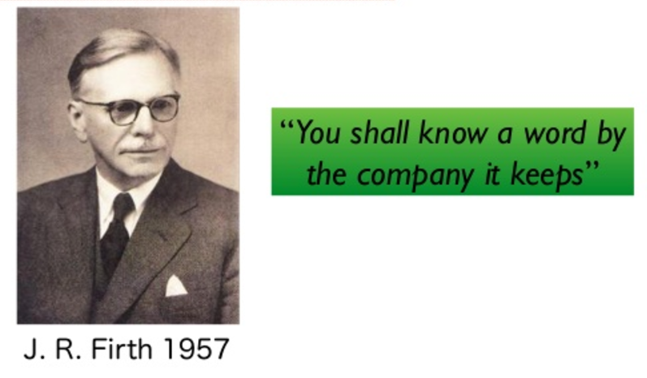
Take home message

Slide 85
Applications using Ngrams
Collocation or MWE Identification
Terminology/Ontology Building
Topic Identification
Spelling Correction
Feature Selection

Slide 86
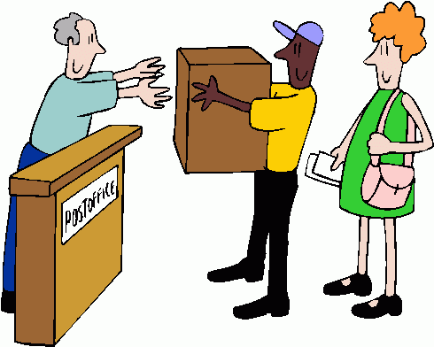


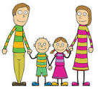
Collocations / Multi-word Expressions
Post Office
Nuclear family
spider crab

Slide 87



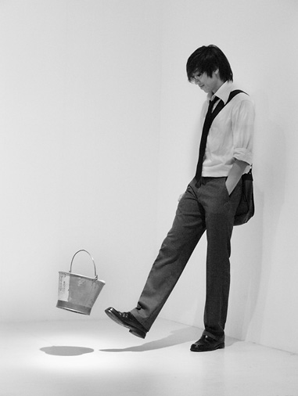


Collocations: Idioms
Kick the bucket
Pain in the neck
Black and blue

Slide 88


Collocations
We walked past the white house.
Looking at the distribution of
ngrams in the corpus can help
us determine which is being
referred to.
Documents ?
1. press releases
2. real estate notices

Slide 89
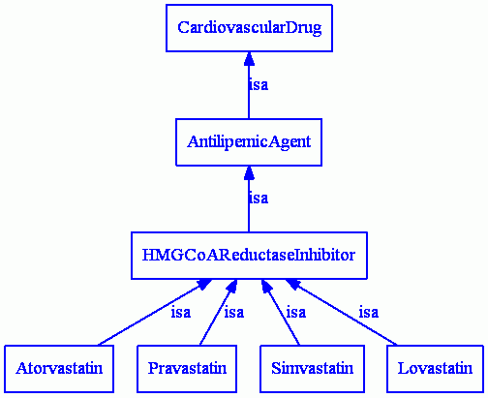
Terminology/Ontology Building
Prospective
Terms
Biomedical
Documents

Slide 90
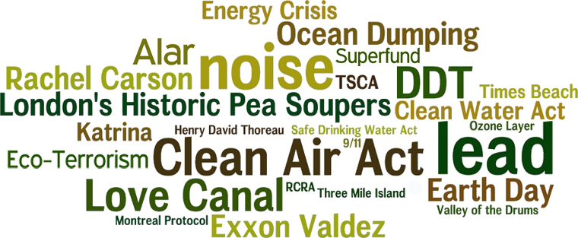
Topic Identification

Slide 91
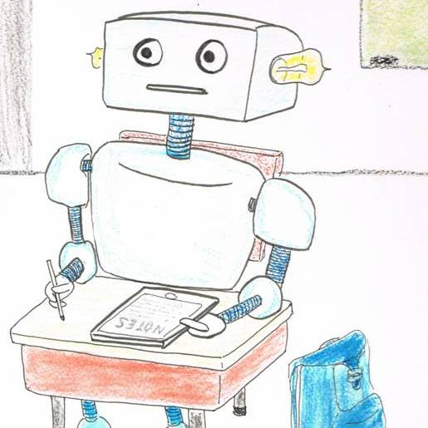
Feature Selection

Slide 92
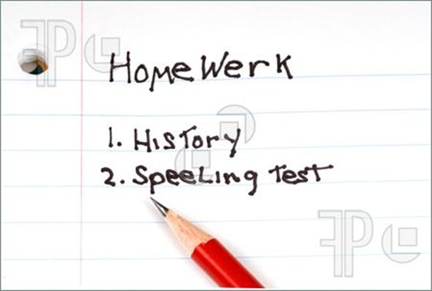
Spelling Correction

Slide 93
A lot of these tasks
Use the probability of an n-gram occurring
in the text:
we already know how to rank n-grams
based on their relative frequency

Slide 94
Ngram Probability – last lecture
 | i | want | to | eat | chinese | food | lunch | spend | <start> | <end>
i | 0.002 | 0.33 | 0 | 0.0036 | 0 | 0 | 0 | 0.00079 | 0 | 0
want | 0.0022 | 0 | 0.66 | 0.0011 | 0.0065 | 0.0065 | 0.0064 | 0.0011 | 0 | 0
to | 0.00083 | 0 | 0.0017 | 0.28 | 0.00083 | 0 | 0.0025 | 0.087 | 0 | 0
eat | 0 | 0 | 0.0027 | 0 | 0.021 | 0.0027 | 0.056 | 0 | 0 | 0.011
chinese | 0.0063 | 0 | 0 | 0 | 0 | 0.52 | 0.0063 | 0 | 0 | 0.008
food | 0.014 | 0 | 0.014 | 0 | 0.00092 | 0.0037 | 0 | 0 | 0 | 0.004
lunch | 0.0059 | 0 | 0 | 0 | 0 | 0.0029 | 0 | 0 | 0 | 0.003
spend | 0.0036 | 0 | 0.0036 | 0 | 0 | 0 | 0 | 0 | 1 | 0.006
<start> | 0.015 | 0 | 0.01 | 0 | 0.005 | 0.003 | 0.001 | 0 | 0 | 0
<end> | 0 | 0 | 0 | 0 | 0.001 | 0.007 | 0.002 | 0.011 | 0 | 0
CORPUS
Relative Frequency Table

Slide 95
Another way to look at this
Likelihood the tokens in the n-gram tend
to occur together
more often than one would expect by chance
Ngram Statistics

Slide 96
Ngram statistics
Statistical measures are computed using various
co-occurrence
and
individual frequency counts

Slide 97
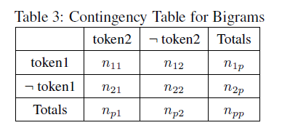
Contingency Table

Slide 98
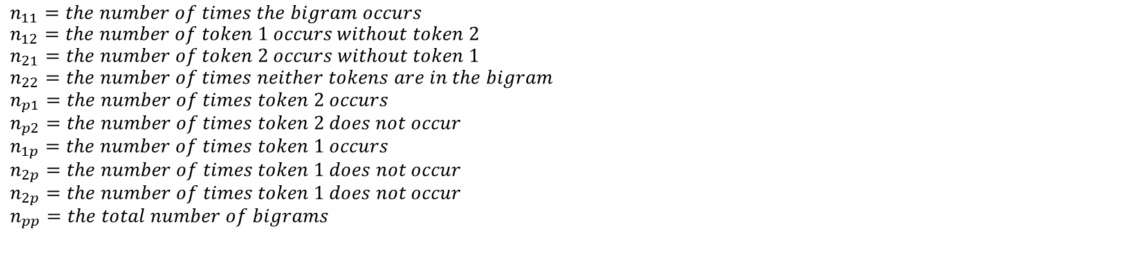
Contingency Table
$$n_{11}=the number of times the bigram occurs$$
$$n_{12}=the number of token 1 occurs without token 2$$
$$n_{21}=the number of token 2 occurs without token 1$$
$$n_{22}=the number of times neither tokens are in the bigram$$
$$n_{p1}=the number of times token 2 occurs$$
$$n_{p2}=the number of times token 2 does not occur$$
$$n_{1p}=the number of times token 1 occurs$$
$$n_{2p}=the number of times token 1 does not occur$$
$$n_{2p}=the number of times token 1 does not occur$$
$$n_{pp}=the total number of bigrams$$

Slide 99
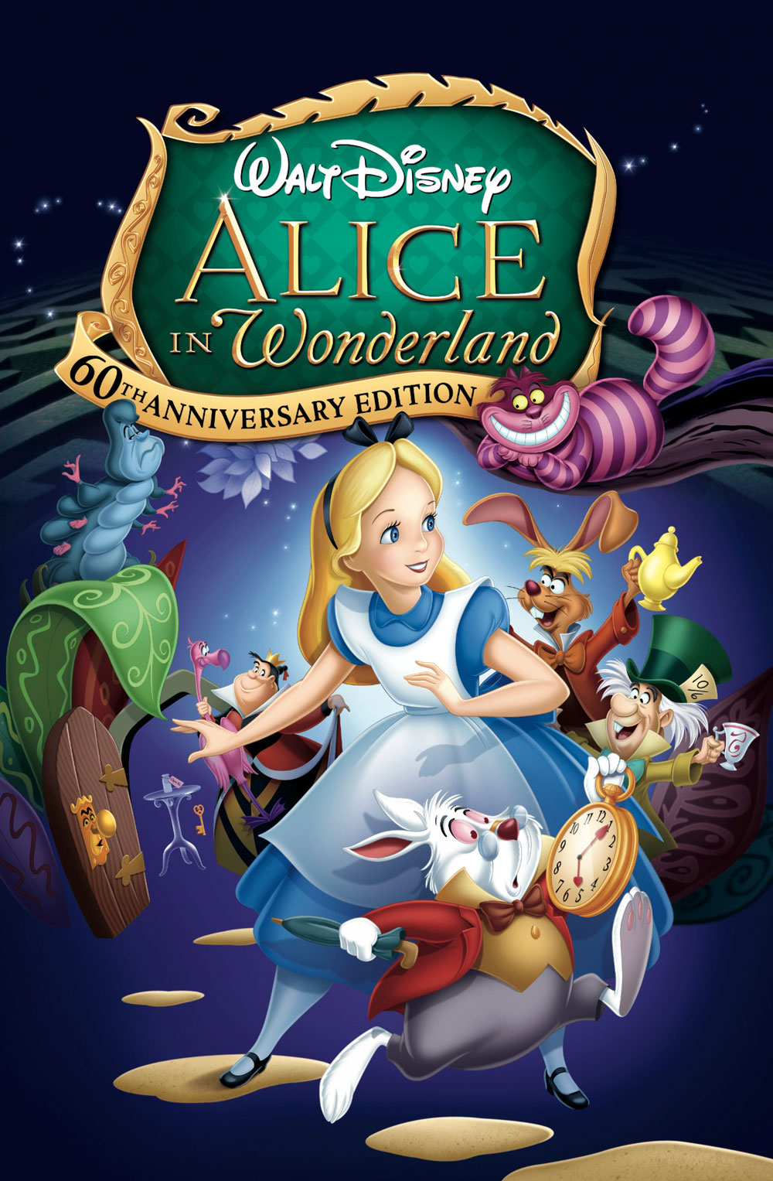
Example: white rabbit
 | $$rabbit$$ | $$¬rabbit$$
$$white$$ | $$n_{11}=21$$ | $$n_{12}=5$$ | $$n_{1p}=26$$
$$¬white$$ | $n_{21}=2$ | $$n_{22}=3757$$ | $$n_{2p}=3759$$
 | $$n_{p1}=23$$ | $$n_{p2}=3762$$ | $$n_{pp}=3785$$

Slide 100
Okay so we have our frequency counts …
Now what?
The next step is:
to approximate the expected value
of the n-gram if it
occurred by chance in the corpus

Slide 101
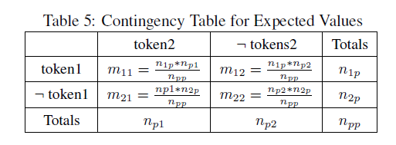
Expected Values

Slide 102
Expected Values
 | $$rabbit$$ | $$¬rabbit$$
$$white$$ | $$n_{11}=21$$ | $$n_{12}=5$$ | $$n_{1p}=26$$
$$¬rabbit$$ | $n_{21}=2$ | $$n_{22}=3757$$ | $$n_{2p}=3759$$
 | $$n_{p1}=23$$ | $$n_{p2}=3762$$ | $$n_{pp}=3785$$

Slide 103
Expected values
Seen values | $$rabbit$$ | $$¬rabbit$$
$$white$$ | $$n_{11}=21$$ | $$n_{12}=5$$ | $$n_{1p}=26$$
$$¬rabbit$$ | $n_{21}=2$ | $$n_{22}=3757$$ | $$n_{2p}=3759$$
 | $$n_{p1}=23$$ | $$n_{p2}=3762$$ | $$n_{pp}=3785$$
Expected values | $$rabbit$$ | $$¬rabbit$$
$$white$$ | $$m_{11}=?$$ | $$m_{12}=?$$ | $$n_{1p}=26$$
$$¬rabbit$$ | $m_{21}=?$ | $$m_{22}=?$$ | $$n_{2p}=3759$$
 | $$n_{p1}=23$$ | $$n_{p2}=3762$$ | $$n_{pp}=3785$$

Slide 104
Expected values
Seen values | $$rabbit$$ | $$¬rabbit$$
$$white$$ | $$n_{11}=21$$ | $$n_{12}=5$$ | $$n_{1p}=26$$
$$¬rabbit$$ | $n_{21}=2$ | $$n_{22}=3757$$ | $$n_{2p}=3759$$
 | $$n_{p1}=23$$ | $$n_{p2}=3762$$ | $$n_{pp}=3785$$
Expected values | $$rabbit$$ | $$¬rabbit$$
$$white$$ | $$m_{11}=?$$ | $$m_{12}=?$$ | $$n_{1p}=26$$
$$¬rabbit$$ | $m_{21}=?$ | $$m_{22}=?$$ | $$n_{2p}=3759$$
 | $$n_{p1}=23$$ | $$n_{p2}=3762$$ | $$n_{pp}=3785$$
$m_{11}= \frac{n_{1p} ∗ n_{p1}}{n_{pp}}$ = $\frac{23 ∗26 }{3785}=0.1579$

Slide 105
Expected values
Seen values | $$rabbit$$ | $$¬rabbit$$
$$white$$ | $$n_{11}=21$$ | $$n_{12}=5$$ | $$n_{1p}=26$$
$$¬rabbit$$ | $n_{21}=2$ | $$n_{22}=3757$$ | $$n_{2p}=3759$$
 | $$n_{p1}=23$$ | $$n_{p2}=3762$$ | $$n_{pp}=3785$$
Expected values | $$rabbit$$ | $$¬rabbit$$
$$white$$ | $$m_{11}=0.1579$$ | $$m_{12}=?$$ | $$n_{1p}=26$$
$$¬rabbit$$ | $m_{21}=?$ | $$m_{22}=?$$ | $$n_{2p}=3759$$
 | $$n_{p1}=23$$ | $$n_{p2}=3762$$ | $$n_{pp}=3785$$
$m_{11}= \frac{n_{1p} ∗ n_{p1}}{n_{pp}}$ = $\frac{23 ∗26 }{3785}=0.1579$

Slide 106
Expected values
Seen values | $$rabbit$$ | $$¬rabbit$$
$$white$$ | $$n_{11}=21$$ | $$n_{12}=5$$ | $$n_{1p}=26$$
$$¬rabbit$$ | $n_{21}=2$ | $$n_{22}=3757$$ | $$n_{2p}=3759$$
 | $$n_{p1}=23$$ | $$n_{p2}=3762$$ | $$n_{pp}=3785$$
Expected values | $$rabbit$$ | $$¬rabbit$$
$$white$$ | $$m_{11}=0.1579$$ | $$m_{12}=?$$ | $$n_{1p}=26$$
$$¬rabbit$$ | $m_{21}=?$ | $$m_{22}=?$$ | $$n_{2p}=3759$$
 | $$n_{p1}=23$$ | $$n_{p2}=3762$$ | $$n_{pp}=3785$$
$m_{12}= \frac{n_{1p} ∗ n_{p2}}{n_{pp}}$ = $\frac{23 ∗3762}{3785}=22.8602$

Slide 107

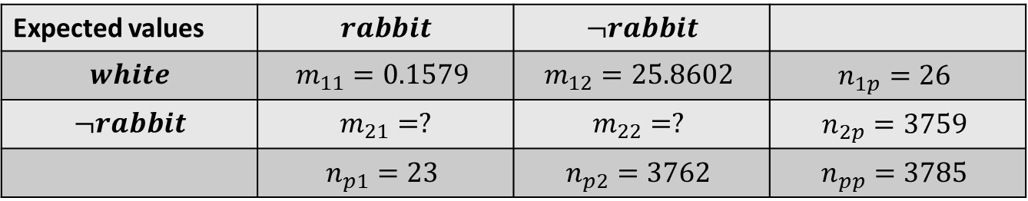
Expected values
Seen values | $$rabbit$$ | $$¬rabbit$$
$$white$$ | $$n_{11}=21$$ | $$n_{12}=5$$ | $$n_{1p}=26$$
$$¬rabbit$$ | $n_{21}=2$ | $$n_{22}=3757$$ | $$n_{2p}=3759$$
 | $$n_{p1}=23$$ | $$n_{p2}=3762$$ | $$n_{pp}=3785$$
Expected values | $$rabbit$$ | $$¬rabbit$$
$$white$$ | $$m_{11}=0.1579$$ | $$m_{12}=25.8602$$ | $$n_{1p}=26$$
$$¬rabbit$$ | $m_{21}=?$ | $$m_{22}=?$$ | $$n_{2p}=3759$$
 | $$n_{p1}=23$$ | $$n_{p2}=3762$$ | $$n_{pp}=3785$$
$m_{12}= \frac{n_{1p} ∗ n_{p2}}{n_{pp}}$ = $\frac{23 ∗3762}{3785}=25.8602$

Slide 108

Expected values
Seen values | $$rabbit$$ | $$¬rabbit$$
$$white$$ | $$n_{11}=21$$ | $$n_{12}=5$$ | $$n_{1p}=26$$
$$¬rabbit$$ | $n_{21}=2$ | $$n_{22}=3757$$ | $$n_{2p}=3759$$
 | $$n_{p1}=23$$ | $$n_{p2}=3762$$ | $$n_{pp}=3785$$
Expected values | $$rabbit$$ | $$¬rabbit$$
$$white$$ | $$m_{11}=0.1579$$ | $$m_{12}=25.8602$$ | $$n_{1p}=26$$
$$¬rabbit$$ | $m_{21}=?$ | $$m_{22}=?$$ | $$n_{2p}=3759$$
 | $$n_{p1}=23$$ | $$n_{p2}=3762$$ | $$n_{pp}=3785$$
$m_{21}= \frac{n_{2p} ∗ n_{p1}}{n_{pp}}$ = $\frac{3759 ∗23}{3785}=25.8420$

Slide 109
Expected values
Seen values | $$rabbit$$ | $$¬rabbit$$
$$white$$ | $$n_{11}=21$$ | $$n_{12}=5$$ | $$n_{1p}=26$$
$$¬rabbit$$ | $n_{21}=2$ | $$n_{22}=3757$$ | $$n_{2p}=3759$$
 | $$n_{p1}=23$$ | $$n_{p2}=3762$$ | $$n_{pp}=3785$$
Expected values | $$rabbit$$ | $$¬rabbit$$
$$white$$ | $$m_{11}=0.1579$$ | $$m_{12}=22.8602$$ | $$n_{1p}=26$$
$$¬rabbit$$ | $m_{21}=22.8420$ | $$m_{22}=?$$ | $$n_{2p}=3759$$
 | $$n_{p1}=23$$ | $$n_{p2}=3762$$ | $$n_{pp}=3785$$
$m_{21}= \frac{n_{2p} ∗ n_{p1}}{n_{pp}}$ = $\frac{3759 ∗23}{3785}=22.8420$

Slide 110
Expected values
Seen values | $$rabbit$$ | $$¬rabbit$$
$$white$$ | $$n_{11}=21$$ | $$n_{12}=5$$ | $$n_{1p}=26$$
$$¬rabbit$$ | $n_{21}=2$ | $$n_{22}=3757$$ | $$n_{2p}=3759$$
 | $$n_{p1}=23$$ | $$n_{p2}=3762$$ | $$n_{pp}=3785$$
Expected values | $$rabbit$$ | $$¬rabbit$$
$$white$$ | $$m_{11}=0.1579$$ | $$m_{12}=22.8602$$ | $$n_{1p}=26$$
$$¬rabbit$$ | $m_{21}=22.8420$ | $$m_{22}=?$$ | $$n_{2p}=3759$$
 | $$n_{p1}=23$$ | $$n_{p2}=3762$$ | $$n_{pp}=3785$$
$m_{22}= \frac{n_{2p} ∗ n_{p2}}{n_{pp}}$ = $\frac{3759 ∗3762}{3785}=3736.1579$

Slide 111
Expected values
Seen values | $$rabbit$$ | $$¬rabbit$$
$$white$$ | $$n_{11}=21$$ | $$n_{12}=5$$ | $$n_{1p}=26$$
$$¬rabbit$$ | $n_{21}=2$ | $$n_{22}=3757$$ | $$n_{2p}=3759$$
 | $$n_{p1}=23$$ | $$n_{p2}=3762$$ | $$n_{pp}=3785$$
Expected values | $$rabbit$$ | $$¬rabbit$$
$$white$$ | $$m_{11}=0.1579$$ | $$m_{12}=22.8602$$ | $$n_{1p}=26$$
$$¬rabbit$$ | $m_{21}=22.8420$ | $$m_{22}=3736.1579$$ | $$n_{2p}=3759$$
 | $$n_{p1}=23$$ | $$n_{p2}=3762$$ | $$n_{pp}=3785$$
$m_{22}= \frac{n_{2p} ∗ n_{p2}}{n_{pp}}$ = $\frac{3759 ∗3762}{3785}=3736.1579$

Slide 112
Likelihood
Now we have our known values and we have our expected values
Next: we can calculate the likelihood the tokens in the n-gram
have occurred together by chance

Slide 113
Measures of Association
Number of measures of association
Mutual Information
Log Likelihood
Chi Squared
Dice co-efficient
…. the list goes on

Slide 114
Log Likelihood Ratio ($G^{2})$
$$G^{2}=2 ∗ \sum_{i}^{j}{n_{ij} ∗\log{(\frac{n_{ij}}{m_{ij}}})}$$

Slide 115
Basic idea
We are taking the log ratio of our known
values over our expected values

Slide 116
Seen values | $$rabbit$$ | $$¬rabbit$$
$$white$$ | $$n_{11}=21$$ | $$n_{12}=5$$ | $$n_{1p}=26$$
$$¬rabbit$$ | $n_{21}=2$ | $$n_{22}=3757$$ | $$n_{2p}=3759$$
 | $$n_{p1}=23$$ | $$n_{p2}=3762$$ | $$n_{pp}=3785$$
$$G^{2}=2 ∗ \sum_{i}^{j}{n_{ij} ∗\log{(\frac{n_{ij}}{m_{ij}}})}$$
i, j = { 1, 2}
We have:
Seen values
Expected values
Expected values | $$rabbit$$ | $$¬rabbit$$
$$white$$ | $$m_{11}=0.1579$$ | $$m_{12}=22.8602$$ | $$n_{1p}=26$$
$$¬rabbit$$ | $m_{21}=22.8420$ | $$m_{22}=?$$ | $$n_{2p}=3759$$
 | $$n_{p1}=23$$ | $$n_{p2}=3762$$ | $$n_{pp}=3785$$

Slide 117
Seen values | $$rabbit$$ | $$¬rabbit$$
$$white$$ | $$n_{11}=21$$ | $$n_{12}=5$$ | $$n_{1p}=26$$
$$¬rabbit$$ | $n_{21}=2$ | $$n_{22}=3757$$ | $$n_{2p}=3759$$
 | $$n_{p1}=23$$ | $$n_{p2}=3762$$ | $$n_{pp}=3785$$
$$G^{2}=2 ∗ \sum_{i}^{j}{n_{ij} ∗\log{(\frac{n_{ij}}{m_{ij}}})}$$
i, j = { 1, 2}
We have:
Seen values
Expected values
Expected values | $$rabbit$$ | $$¬rabbit$$
$$white$$ | $$m_{11}=0.1579$$ | $$m_{12}=22.8602$$ | $$n_{1p}=26$$
$$¬rabbit$$ | $m_{21}=22.8420$ | $$m_{22}=?$$ | $$n_{2p}=3759$$
 | $$n_{p1}=23$$ | $$n_{p2}=3762$$ | $$n_{pp}=3785$$
$$G^{2}=2 ∗( \left(n_{11} ∗\log\left(\frac{n_{11}}{m_{11}}\right)\right)+$$
$\left(n_{12} ∗\log\left(\frac{n_{12}}{m_{12}}\right)\right)+$
$\left(n_{21} ∗\log\left(\frac{n_{21}}{m_{21}}\right)\right)+$
$\left(n_{22} ∗\log\left(\frac{n_{22}}{m_{22}}\right)\right)$ )

Slide 118
Seen values | $$rabbit$$ | $$¬rabbit$$
$$white$$ | $$n_{11}=21$$ | $$n_{12}=5$$ | $$n_{1p}=26$$
$$¬rabbit$$ | $n_{21}=2$ | $$n_{22}=3757$$ | $$n_{2p}=3759$$
 | $$n_{p1}=23$$ | $$n_{p2}=3762$$ | $$n_{pp}=3785$$
$$G^{2}=2 ∗ \sum_{i}^{j}{n_{ij} ∗\log{(\frac{n_{ij}}{m_{ij}}})}$$
i, j = { 1, 2}
We have:
Seen values
Expected values
Expected values | $$rabbit$$ | $$¬rabbit$$
$$white$$ | $$m_{11}=0.1579$$ | $$m_{12}=22.8602$$ | $$n_{1p}=26$$
$$¬rabbit$$ | $m_{21}=22.8420$ | $$m_{22}=?$$ | $$n_{2p}=3759$$
 | $$n_{p1}=23$$ | $$n_{p2}=3762$$ | $$n_{pp}=3785$$
$$G^{2}=2 ∗( \left(n_{11} ∗\log\left(\frac{n_{11}}{m_{11}}\right)\right)+$$
$\left(n_{12} ∗\log\left(\frac{n_{12}}{m_{12}}\right)\right)+$
$\left(n_{21} ∗\log\left(\frac{n_{21}}{m_{21}}\right)\right)+$
$\left(n_{22} ∗\log\left(\frac{n_{22}}{m_{22}}\right)\right)$ )
$$G^{2}=2 ∗( \left(21 ∗\log\left(\frac{21}{0.1579}\right)\right)+$$
$\left(5 ∗\log\left(\frac{5}{22.8602}\right)\right)+$
$\left(2 ∗\log\left(\frac{2}{22.8420}\right)\right)+$
$\left(3767 ∗\log\left(\frac{3757}{3762}\right)\right)$ ) = 221.0014

Slide 119
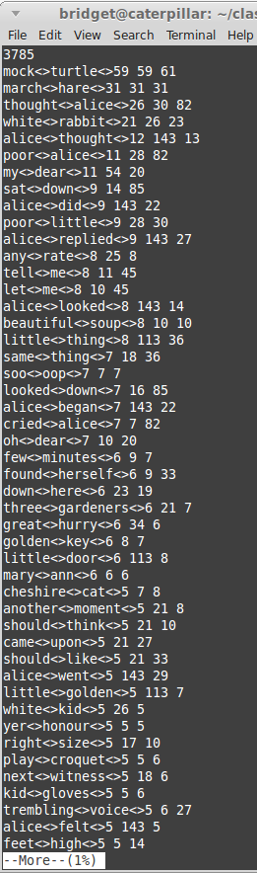
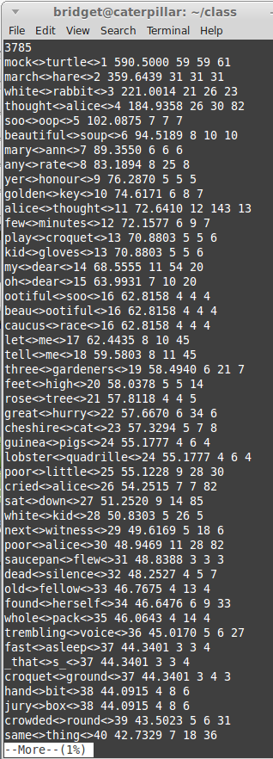
Left hand column: frequency
Right hand column: Log Likelihood

Slide 120
Left hand column: frequency
Right hand column: Log Likelihood
4
3

Slide 121
Left hand column: frequency
Right hand column: Log Likelihood
So it is weighting the ngram based on its distribution with respect to the other tokens in the ngram
5
11

Slide 122
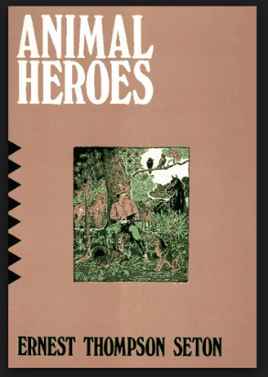
white rabbit from two different corpora
Seen values | $$rabbit$$ | $$¬rabbit$$
$$white$$ | $$n_{11}=21$$ | $$n_{12}=5$$ | $$n_{1p}=26$$
$$¬rabbit$$ | $n_{21}=2$ | $$n_{22}=3757$$ | $$n_{2p}=3759$$
 | $$n_{p1}=23$$ | $$n_{p2}=3762$$ | $$n_{pp}=3785$$
$$G^{2}=221.0014$$
Seen values | $$rabbit$$ | $$¬rabbit$$
$$white$$ | $$n_{11}=1$$ | $$n_{12}=82$$ | $$n_{1p}=83$$
$$¬rabbit$$ | $n_{21}=23$ | $$n_{22}=9289$$ | $$n_{2p}=9312$$
 | $$n_{p1}=24$$ | $$n_{p2}=9371$$ | $$n_{pp}=9395$$
$$G^{2}=1.5601$$

Slide 123
Application: Feature Selection
Threshold
Cutoff

Slide 124
Application: Context Sensitive
Spelling Correction
We went to Paris and stayed (their|there)? eleven days
P(stayed their eleven) vs P(stayed there eleven)
Backoff model
Avg(P(stayed their), P(their eleven)) vs Avg(P(stayed there), P(there eleven))

Slide 125
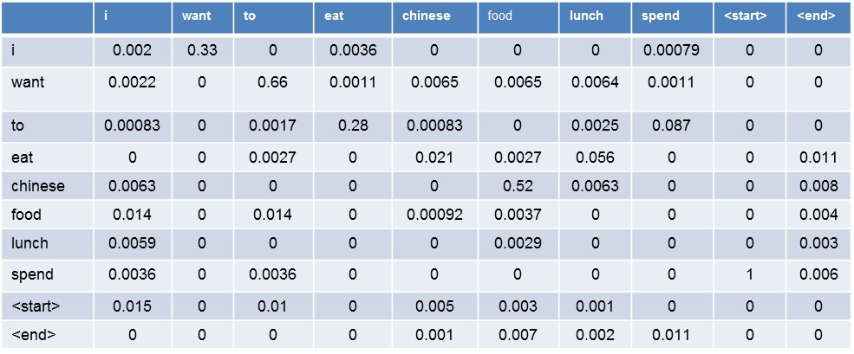
Application: Context Sensitive
Spelling Correction
We went to Paris and stayed (their|there)? eleven days
P(stayed their eleven) vs P(stayed there eleven)
Backoff model
Avg(P(stayed their), P(their eleven)) vs Avg(P(stayed there), P(there eleven))
Relative Frequency Table

Slide 126
Application: Context Sensitive Spelling Correction
$$G^{2}Table$$
We went to Paris and stayed (their|there)? eleven days
Backoff model
Avg(P(stayed their), P(their eleven)) vs Avg(P(stayed there), P(there eleven))
Avg($G^{2}$(stayed their), $G^{2}$(their eleven)) vs Avg($G^{2}$(stayed there), $G^{2}$(there eleven))

Slide 127
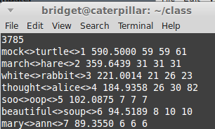
Application: Collocations, Terms and Multiword Expressions?
Ngrams that are collocations, terms and mwes
are more likely to occur together than by chance

Slide 128
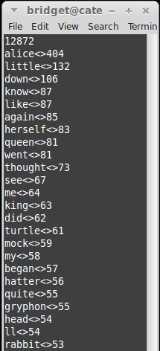
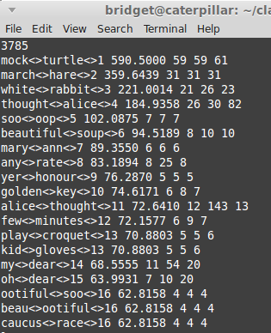
Application: Topic Identification
Terms
provide more specific contextual information
than individual words

Slide 129
Questions?

Slide 130
Association Measures continued

Slide 131
Ngram: Tokenization
Extracting Relevant Contextual information from the text
Alice in Wonderland
and
Bigrams

Slide 132
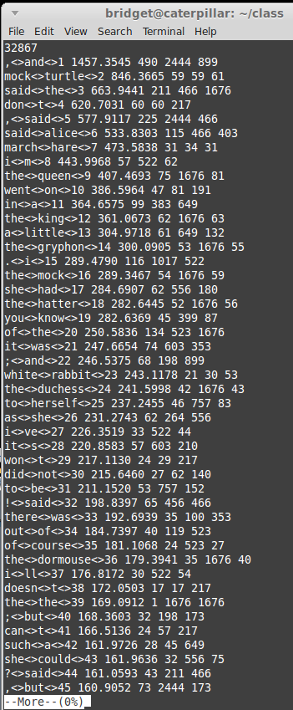

These ngrams are
a little different than
we saw before
N-gram Extractor

Slide 133
Uh oh – what is the
Problem?
Lots of punctuation
And
Non-content tokens
N-gram Extractor

Slide 134
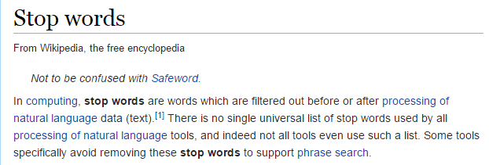
Stopwords
These are often words
that do not provide any contextual
information for the task at hand
e.g. if we were analyzing clinical notes the token patient is often removed
because it provides no contextual information – all the notes are
about patients.
Punctuation
Is often included in the stopword list

Slide 135
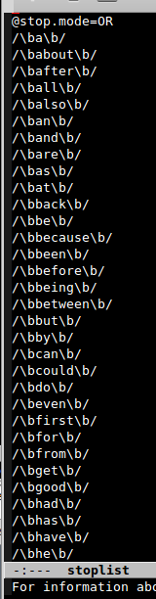
Example Stopword
They are in regular expression form
Makes them powerful
E.g. /\b\d+\b/ -> removes a series of digits without having
to enumerate over all the digits
@stop.mode
OR
Do not include ngram if either word is a stopword
AND
Do not include ngram if both words are a stopword

Slide 136
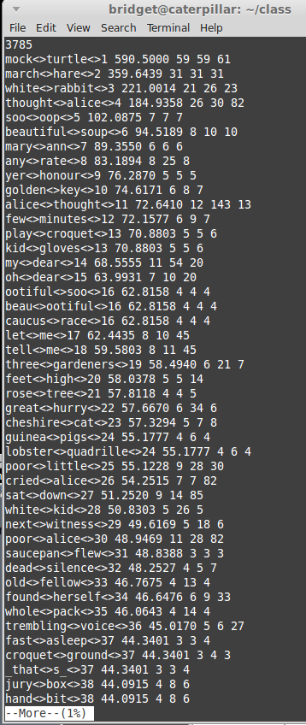
stop
list
N-gram Modeler

Slide 137
Compare the outputs
What can you see
The likelihood score of the top bigrams
has decreased
But
he contextual information of the top
bigrams has increased

Slide 138
Creating a Stoplist
A bit of art … with trial and error.

Slide 139
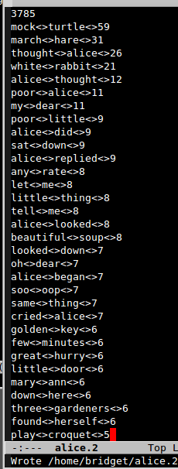
FSA
stop
list
N-gram Modeler
Probability
NLP Application that is using both:
Rules and Probability
Information

Slide 140
Stoplists are commonly used
But … would we necessarily want to use
one with our Spelling Correction Application?
Avg($G^{2}$(stayed their), $G^{2}$(their eleven)) vs Avg($G^{2}$(stayed there), $G^{2}$(there eleven))
We went to Paris and stayed (their|there)? eleven days

Slide 141
Look a little more at Ngrams
Ngrams
we are going to modify our definition slightly
a continguous or non-continguous sequence of tokens that occur in some proximity to each other in a corpus

Slide 142
Look a little more at Ngrams
Ngrams
We are going to modify our definition slightly
a continguous or non-continguous sequence of tokens that occur in some proximity to each other in a corpus
to be or not to be
Our unique tokens: to be or not to be

Slide 143
Look a little more at Ngrams
Ngrams
We are going to modify our definition slightly
a continguous or non-continguous sequence of tokens that occur in some proximity to each other in a corpus
to be or not to be
Our unigrams are: to be or not to be

Slide 144
Look a little more at Ngrams
Ngrams
We are going to modify our definition slightly
a continguous or non-continguous sequence of tokens that occur in some proximity to each other in a corpus
to be or not to be
Our bigrams are: to be be or or not not to to be

Slide 145
Look a little more at Ngrams
Ngrams
we are going to modify our definition slightly
a contiguous or non-contiguous sequence of tokens that occur in some proximity to each other in a corpus
to be or not to be
Our bigrams are: to be be or or not not to to be
These are contiguous
ngrams – the are situated
next to each other in the text

Slide 146
Non-contiguous n-grams
We open up the window under which an n-gram can occur while still maintaining order
to be or not to be
Our bigrams with a window size of three are:
to be to or

Slide 147
Non-contiguous n-grams
We open up the window under which an n-gram can occur while still maintaining order
to be or not to be
Our bigrams with a window size of three are:
to be to or

Slide 148
Non-contiguous n-grams
We open up the window under which an n-gram can occur while still maintaining order
to be or not to be
Our bigrams with a window size of three are:
to be to or be or be not

Slide 149
Non-contiguous n-grams
We open up the window under which an n-gram can occur while still maintaining order
to be or not to be
Our bigrams with a window size of three are:
to be to or be or be not

Slide 150
Non-contiguous n-grams
We open up the window under which an n-gram can occur while still maintaining order
to be or not to be
Our bigrams with a window size of three are:
to be to or be or be not or not or to

Slide 151
Non-contiguous n-grams
We open up the window under which an n-gram can occur while still maintaining order
to be or not to be
Our bigrams with a window size of three are:
to be to or be or be not or not or to not to not be to be

Slide 152
We may think about this with feature selection

Slide 153
Why do this?
Sparsity
Increases the number of tokens seen in the data set while still making them reasonable
Expands the context

Slide 154
Term, Collocation or MWE Identification?

Slide 155
Term, Collocation or MWE Identification?
Probably Not

Slide 156
Spelling Correction
We went to Paris and stayed (their|there)? eleven days
Avg($G^{2}$(stayed their), $G^{2}$(their eleven)) vs Avg($G^{2}$(stayed there), $G^{2}$(there eleven))

Slide 157
Spelling Correction
We went to Paris and stayed (their|there)? eleven days
Avg($G^{2}$(stayed their), $G^{2}$(their eleven)) vs Avg($G^{2}$(stayed there), $G^{2}$(there eleven))
? Maybe?

Slide 158
Spelling Correction
How about smoothing?
We went to Paris and stayed (their|there)? eleven days
Avg($G^{2}$(stayed their), $G^{2}$(their eleven)) vs Avg($G^{2}$(stayed there), $G^{2}$(there eleven))

Slide 159
Questions?

